Slide 1
Impact and ROI Analysis of Glovo & KFC Streetwise 2 Promotion Campaign
Davit Muradyan

Slide 2
Data
Overview
01

Slide 3
Data Overview
Data spans 12 weeks with promotion occurring during weeks 5-8
Metrics include: New Customers, Total Orders, KFC Orders, SW2 Orders
Glovo and KFC objectives: Drive new customers and increase KFC sales respectively

Slide 4
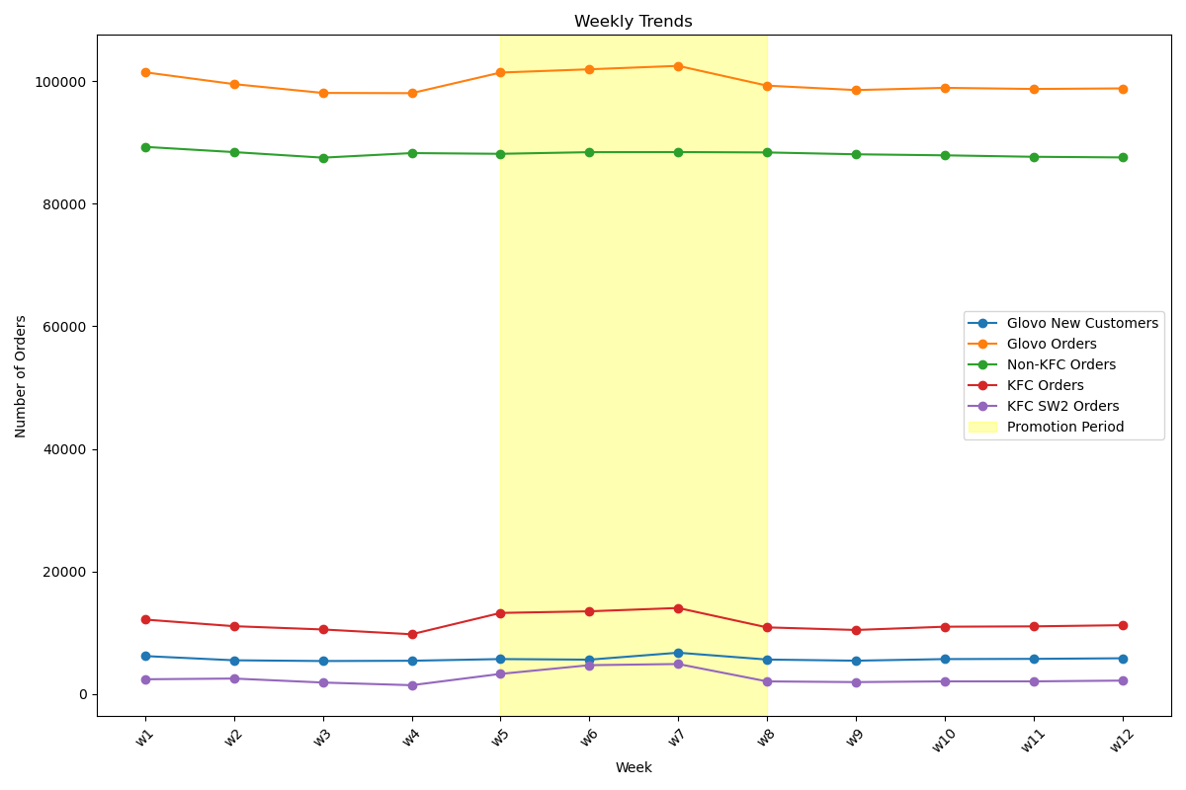
Data Overview

Slide 5
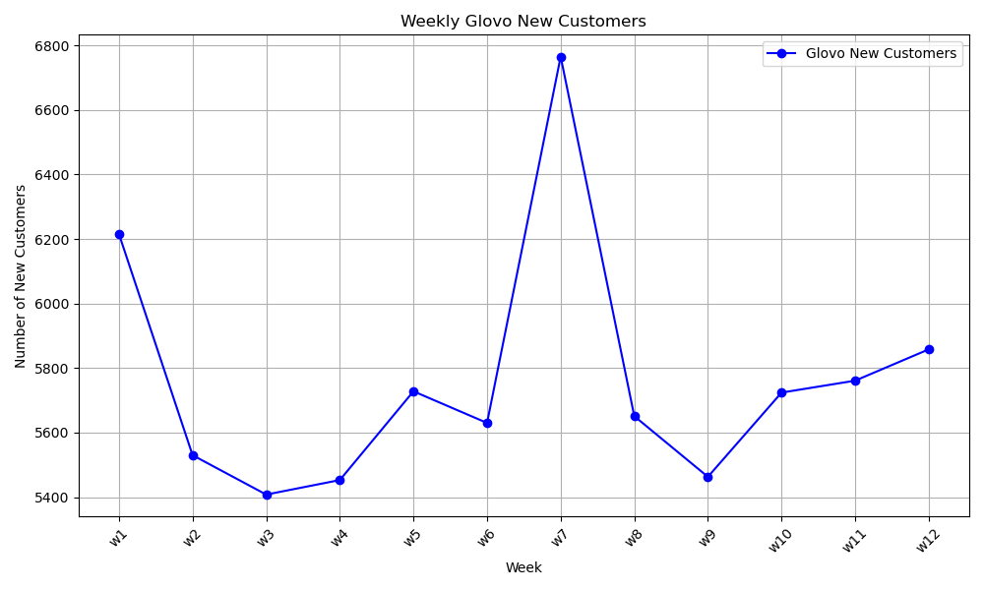
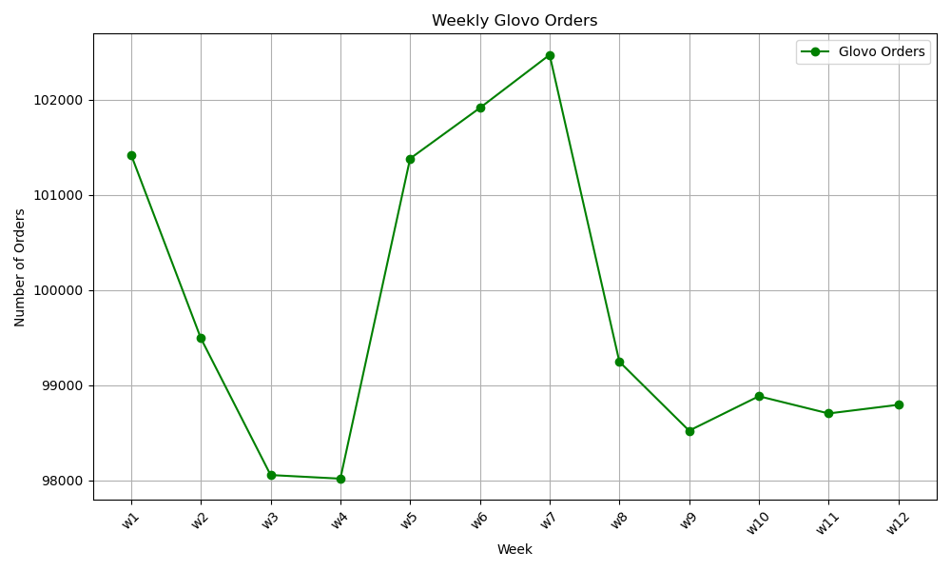
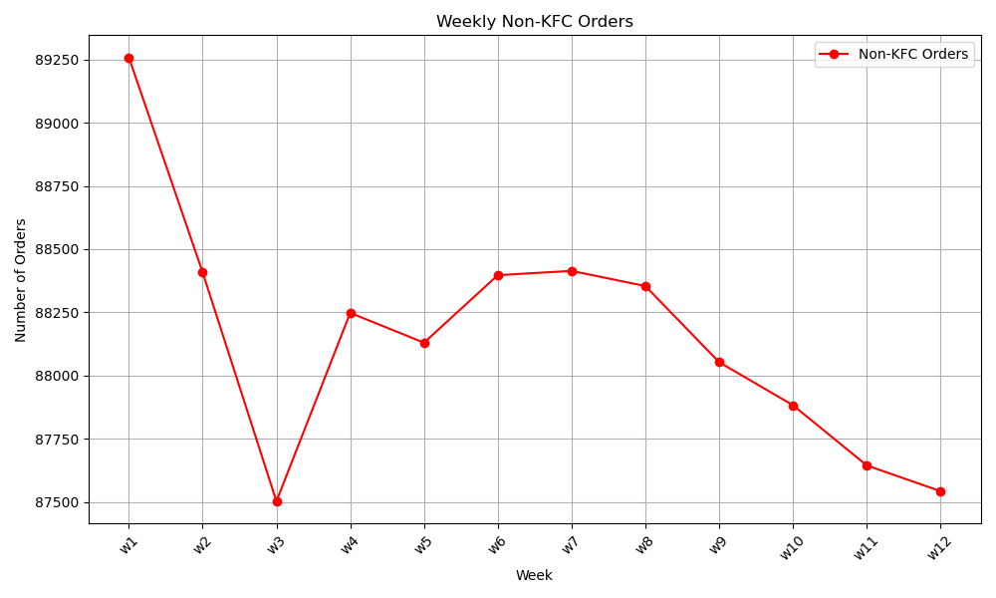
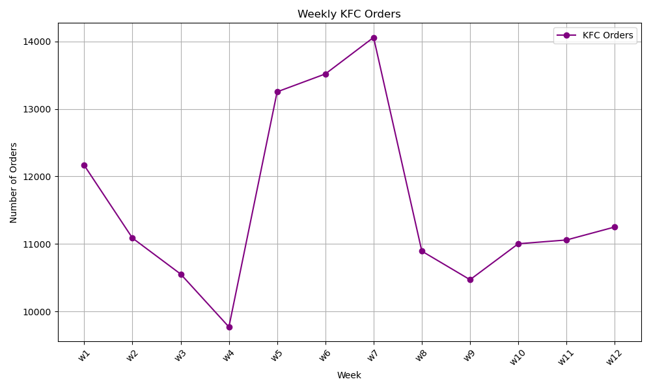
Data Overview

Slide 6
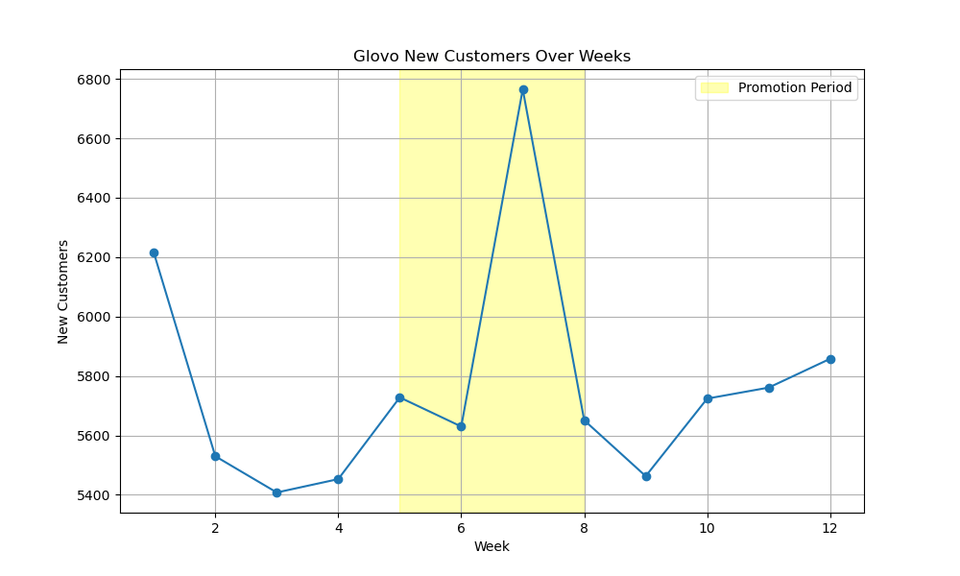
Glovo New Customers over Weeks

Slide 7
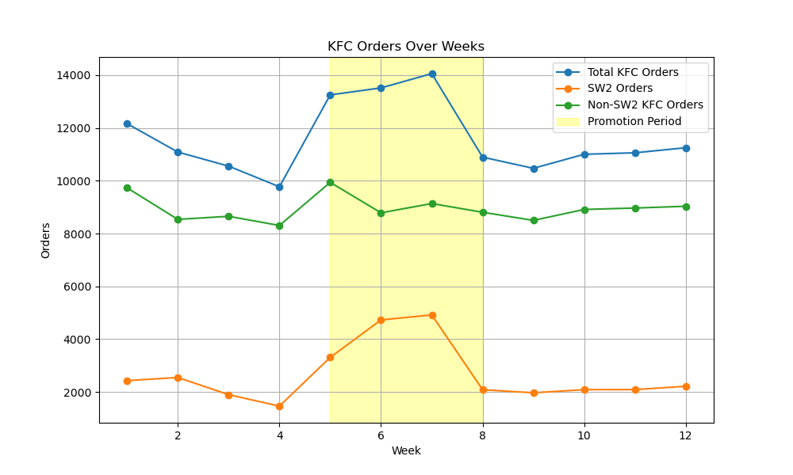
KFC Orders Over Weeks
Analysis shows Non-SW2 KFC orders remain relatively stable before, during and after promotion
SW2 orders increased significantly during promotion weeks
Limited evidence of cannibalization, SW2 promotion mostly adds to total orders

Slide 8
Cost
Analysis
02

Slide 9
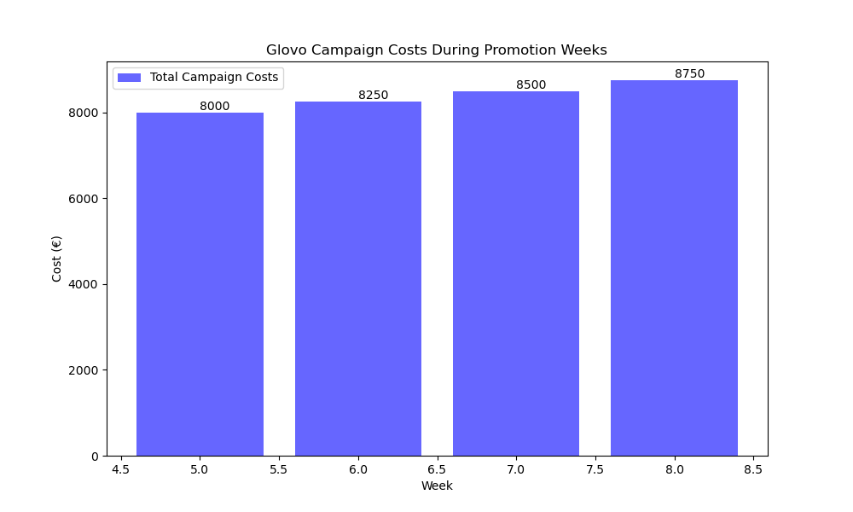
Cost Analysis

Slide 10
Evaluation of Campaign ROI for Glovo
Incremental New Customers (NCs) during promotion +292
Revenue from additional SW2 orders + €55,530
Total campaign costs: €24,667
ROI: (Revenue-Cost)/Cost = 1.43 (143%)
Positive ROI: Campaign Repetition is Advised

Slide 11
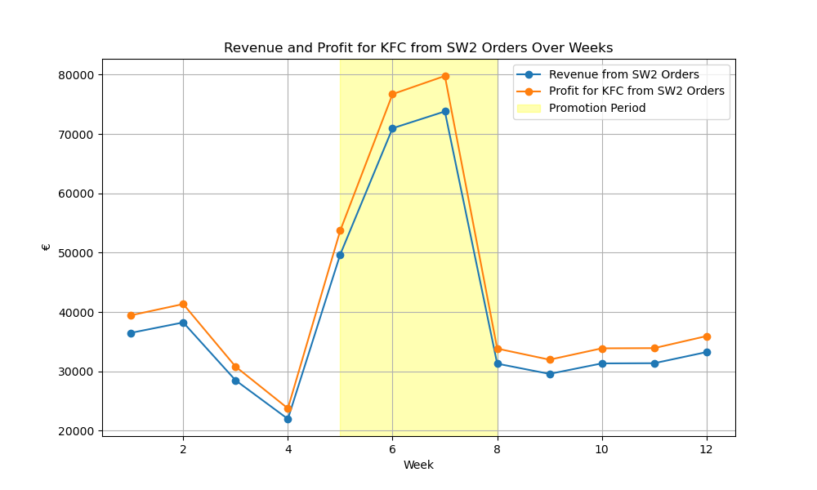
Revenue and Profit for KFC

Slide 12
Revenue and Profit for KFC
The campaign resulted in a substantial profit for KFC, indicating they should consider repeating the campaign
Additional SW2 orders: 3,702
Revenue from additional SW2 orders + €55,530
Cost of discounts (70% of €1.05 per order): 3,702 * €1.05 * 70% = €2,693.49
Margin on additional orders (13%): 3,702 * €15 * 13% = €7,214.10
Net profit: Revenue - Discount cost + Margin = €60,050

Slide 13
Recommendations
For
Future Campaigns

Slide 14
Media Investment
Maintain or slightly increase billboard investment
Consider Digital Marketing

Slide 15
Promo Funding
Test different discount levels to optimize cost-benefit ratio and use that equilibrium point

Slide 16
Performance Marketing
Optimize Spending Based on Performance Metrics
Analyze data to understand which channels are most effective
A/B testing
Conduct A/B tests to compare different ad creatives, messages, and targeting strategies

Slide 17
Thanks
Do you have any questions?
Email: muradyandavit98@gmail.com
Phone: +374 966-920-26

